Slide 1
A Question of Relevance in Management Research Salvatore Vicari, European Management Review, Vol. 10, 173–181 (2013)
António Reynolds Castel-Branco
Professora Doutora Carla Curado
Academics do not turn to managers for inspiration for their research and managers do not consult on theories to develop models and strategies.
Keywords: rigour and relevance; management research; theory and practice; knowledge production; research Knowledge

Slide 2
We have a problem
In 1982, management disciplines were already considered to have little impact on the functioning of organizations (Beyer, 1982).
Academic research on management disseminates theories that are irrelevant and have a negative effect on good management practices, as well as on society (Ghoshal, 2005).
The percentage of managers and consultants who frequently read academic literature is low (Rynes et al., 2002; Rousseau, 2006).

Slide 3
We have a problem
The question of relevance remains unresolved, as science must be closed off from external demands and the world of management, beyond the will of individual researchers or academic institutions (Vicari, 2013).
The lack of relevance is a problem for the scientific community, as it is for the management world: they also have a problem (Vicari, 2013).

Slide 4
Do we have a problem?

Slide 5
The origin of the gap between relevance and rigor
The emergence of management disciplines was dictated by operational needs, generating a feeling of inferiority in academics (Vicari, 2013).
Currently, professionals have the perception that the management sciences produce very in-depth knowledge on irrelevant issues, based on concepts that are fragmented to the point of being useless (Pfeffer and Fong, 2004; Birkenshaw and Mol, 2009).
The arrogance of researchers is considerable (Roux et al., 2006) and they are unable to communicate the few results of interest to companies beyond the restricted circle of scientists...

Slide 6
Relevance and usefulness of knowledge
To develop scientific knowledge, whatever the discipline, the researcher's sole objective must be precisely knowledge and nothing else (Vicari,2013).
Knowledge develops from the curiosity/intellectual freedom of the individual who wants to go beyond the limits of what is already known (Vicari, 2013).
Universities and the scientific community are separate from other social institutions to ensure freedom, without which true knowledge would not be produced (Polany, 1951).
The starting point for the development of knowledge is not in how it is to be used, but in the ability to abstract, to ‘play’ intellectually (Vicari,2013).

Slide 7
Relevance and usefulness of knowledge
Theories and methods are essential elements of the scientific system. Researchers are fundamentally interested in the methodological rigor of scientific evidence, to the detriment of its relevance to business and entrepreneurial realities (Vicari, 2013).
In the management field, the academic system is also closed, dominated by the mechanism of publishing in high prestige journals demanding theory and facts (Hambrick, 2007; Pfeffer, 2009).
From the point of view of social systems theory, individuals must develop their own internal language, based on specific rules, methods and mechanisms that are not influenced by other domains (Luhmann, 1995).

Slide 8
Is therefore “closure” necessary for the functioning of the scientific system, also in the management field?

Slide 9
An unbridgeable gap?
For Vicari (2013), the gap can be bridged, the scientific system in the management field can be ‘disrupted’, exactly as happened in medicine. Thus, the two worlds can only communicate when there is a need , a disruption.
Today, physicians and surgeons are linked to the results of science, many medical discoveries are immediately transformed into new therapeutic practices (Vicari, 2013).

Slide 10
Is there a particular ineliminable problem due to lack of communication between science and practice in the management disciplines?

Slide 11
The creation of management knowledge: the hypothesis of the cognitive process
Managerial methods derive in part from scientific research (Beyer &Trice, 1982; Lawler et al., 1985; Backer, 1991).
The process linking science and practice is very similar to that of the application of knowledge in R&D processes, assuming that research is an antecedent of operational management.
R&D has a procedure of applying theory to practice:
basic research → applied research → product
Using this idea, the transfer of the results of scientific research to the result:
scientific research →applied research → decision making practices

Slide 12
The creation of management knowledge: the hypothesis of the cognitive process
One possible problem in this knowledge transfer may be a language problem, but a solution could be found by using a broker's knowledge (Shapiro et al., 2007).

Slide 13
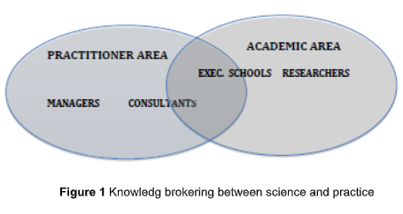
The creation of management knowledge: the hypothesis of the cognitive process
Example of the framework that was identified for research in the technology field (Arora et al., 2001).
In this perspective, consultants and executive education schools, from universities to private training institutions, would have the task of ‘translating’ and transferring the research content into managerial practices ( Starkey et al., 2009).

Slide 14
The creation of management knowledge: the hypothesis of the cognitive process
Although schools and consultants do exist, their mission is not to disseminate scientific knowledge, but rather to collect best practices and then disseminate them (Vicari, 2013).
Unlike technological research, the management knowledge formation process is not a one-way cognitive process, but a very different one (Vicari, 2013).

Slide 15
Where does managers’ knowledge come from?
Researchers, do recognise that managers can produce knowledge (Boyer, 1990; Starkey and Madan, 2001).
The development of knowledge in the scientific world and in the world of management is done differently, the scientific world and the professional world are not linked, being two completely different systems (Van de Ven and Johnson, 2006).

Slide 16
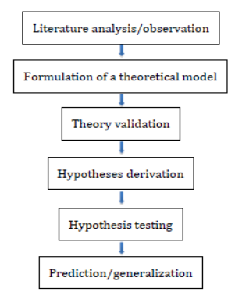
Where does managers’ knowledge come from?
This constitutes a deductive method, but essentially foresees that hypothesis testing is undertaken in the real world or through laboratory simulations.
Figure 2 The formation of new knowledge in academia (Snow and Thomas, 1994)

Slide 17
Where does managers’ knowledge come from?
Knowledge in the field of management is produced in a different way: managers are often faced with new problems, given the evolution of the environment, competition and markets, and in order to solve them they are forced to modify their routines, developing new practices, some of which prove to be adequate, while others are abandoned because they are no longer useful (Nelson and Winter, 1982).

Slide 18
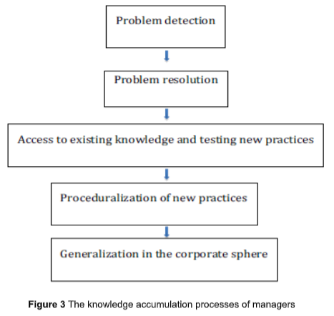
Where does managers’ knowledge come from?
When managers obtain disappointing results from their approaches, they need to correct them or find new methods (Hutchins, 1983; Wallace, 1983; Lave, 1986; Van de Ven and Johnson, 2006).

Slide 19
Where does managers’ knowledge come from?
The processes of accumulating knowledge are carried out in different ways in the two worlds: while in academic research, the criterion is verified/not verified, in management the criterion is useful/not useful for the solution (Vicari,2013).

Slide 20
A possible collaboration between science and management
The question then becomes: How can a closed system such as the managerial disciplines be opened to business interests?
Two conditions have to be met for there to be positive collaboration, which must:
1. be induced by a need, by an external ‘perturbation’; and
2. improve the functioning of both academic and business systems.
Collaboration is only possible on condition that scientists are ‘forced’ to produce relevant research. “Forced”, because the solution will not be born from appeals for cooperation, but from a need (Vicari,2013).

Slide 21
A possible collaboration between science and management
Universities need more and more funding from individuals and companies, given the growing scarcity of public resources for research, increasingly turn to private fund (Mesny and Mailhot, 2012).
If funding for scientific research were linked to the issue of the relevance of results, the research/ relevance gap would be on the way to a solution (Vicari,2013).
Management must continually seek innovative solutions everywhere and academia could become an important source of new solutions (Vicari,2013).

Slide 22
We all have a problem
Leaving the publication of scientific articles solely to companies or a single company, would jeopardise the independence of academic research (Beyer &amp; Trice, 1982; Grey, 2001).
For research to be truly relevant, new ideas must originate from an arena in which different actors operate (Abrahamson, 1996; Sahlin-Andersson and Engwall, 2002).
If companies were to fund research, seeking an operational return, they could make their data available, set up mixed researcher/professional teams and be open to serving as a laboratory for the production of joint research (Vicari, 2013).

Slide 23
We all have a problem
Companies that have a strong network of contacts with university researchers, and a high capacity to evaluate the research produced, are in a good position to overcome the problems that limit their development (Vicari, 2013).
Research activities in collaboration with enterprises are also possible in the field of management, for example in the case of medicine, with doctors agreeing to test new drugs in clinical trials (Gambardella, 2012).
Businesses and managers must perceive the same urgency in solving the problem of relevance and collaboration.

Slide 24
Thank you! Obrigado!

Slide 25
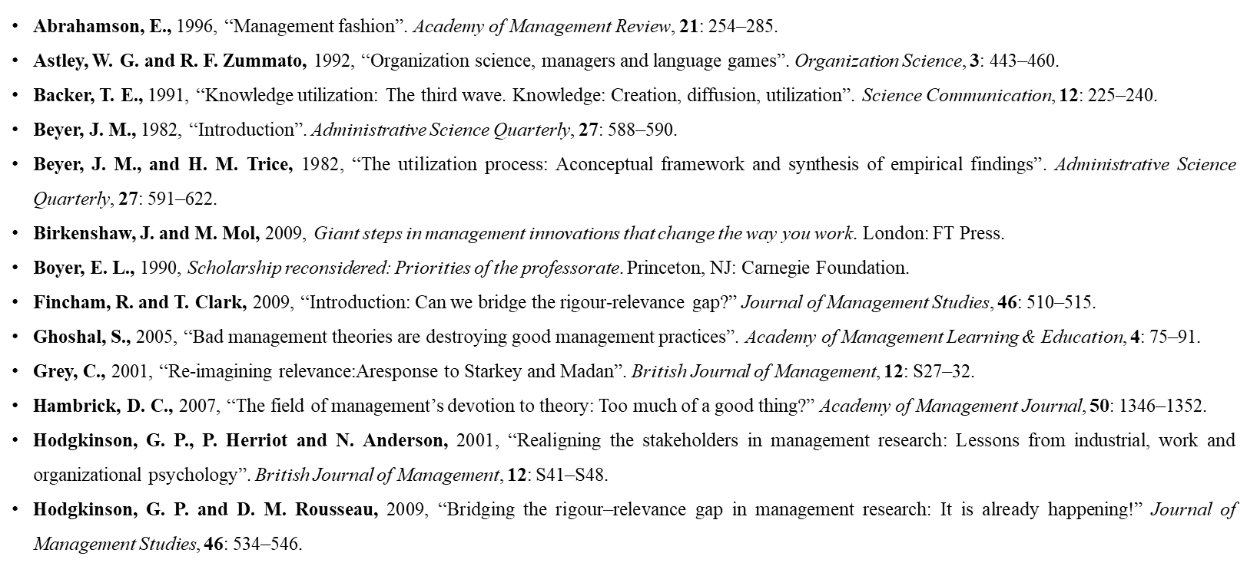
Bibliography

Slide 26
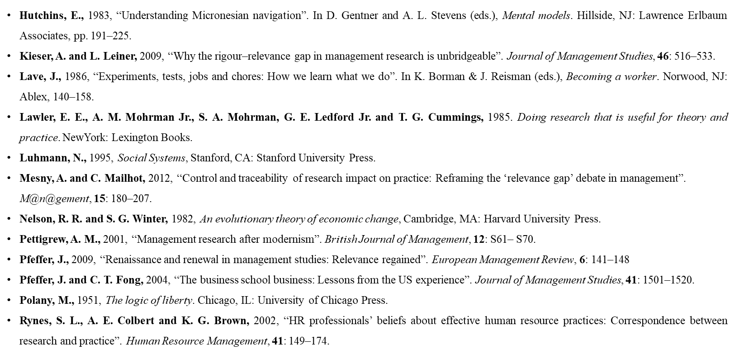
Bibliography

Slide 27
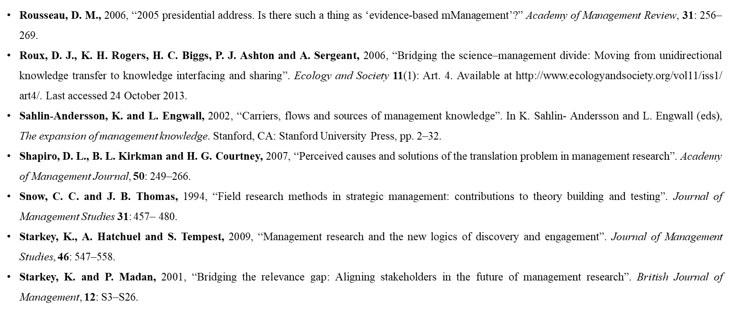
Bibliography

Slide 28
Bibliography

